Slide 1
Results of Meta-DPI

Slide 2
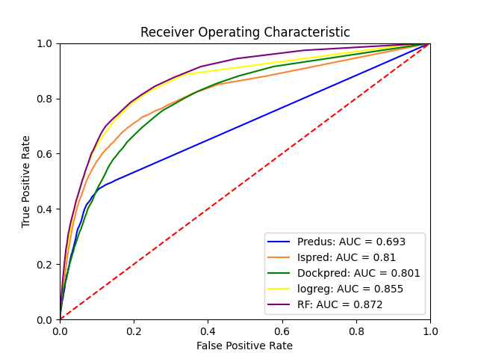
Data 1: ROC Curve
For each set an ROC plot is saved.
This was made without the StAR program.
We imporved on the star program by using more defined colors without overlap.

Slide 3
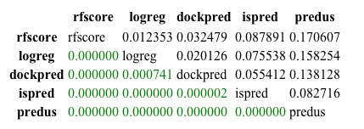
Data type 2: Star chart
This chart is saved as a jpeg and it includes two distinct pieces of information.
The top triangle is the AUC difference
The bottom triangle is is p-values.
Colored in red are points whose p-val is below the cutoff (0.05) and green for above the cutoff.
This allows us to visualize the statistical relevance of predictors.
We have improved on the original Star program by reformatting the index, columns and diagonal to be the full names of the predictors.

Slide 4
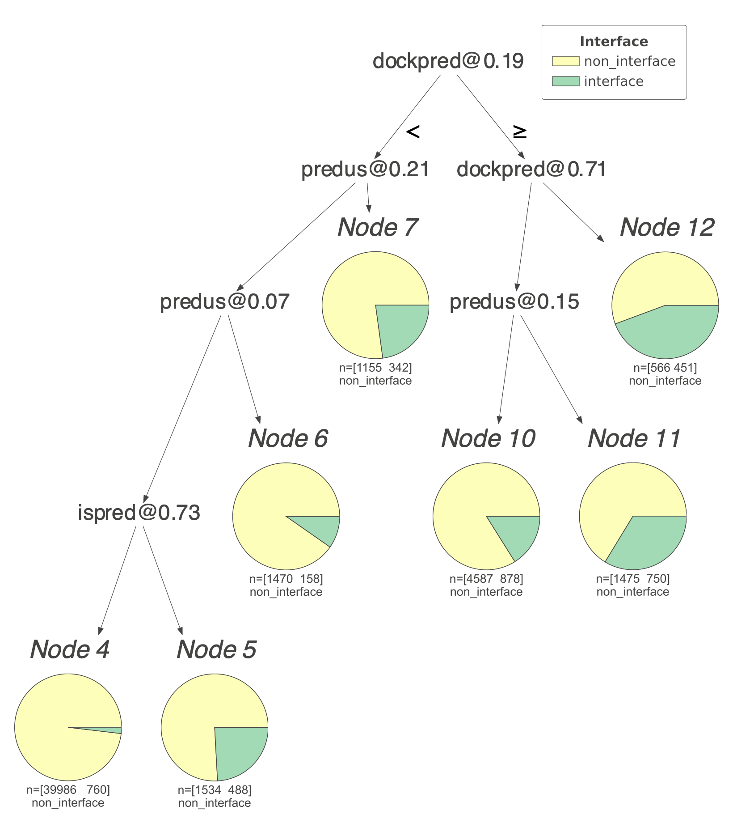
Data 2:Tree Visualization
A visualization program was written on top of dtreeviz
dtreeviz generates a “shadow” on top of the tree in the forest
dtreeviz was modified to suit our needs.
The trees are saved as SVG or vector images for sake of size and scalability
This is a small example of a tree with depth = 10 and ccp_alpha = 0.00105 (harsh post-pruning)

Slide 5
Part 4: Summary of results for RF and MEtaDPI
AUC | predus | ispred | dockpred | logreg | rfscore
5fold | 0.693 | 0.81 | 0.8001 | 0.855 | 0.871
10fold | 0.693 | 0.81 | 0.801 | 0.854 | 0.873
223train |  |  |  | 0.746 | 0.683
louant | 0.517 | 0.753 | 0.538 | 0.614 | 0.661
Average AUC and STDEV

